Slide 1
Data Analysis of
University Graduates in Singapore
Yadanar Aung (P2214621)
DAAA/FT/1B/02
ST1510 PDAS

Slide 2

About Analysis
Ms Tan is the Data Analyst for the Director of Ministry of Student Development in MOE.
She wants to analyse how University Graduates' Population & Gender Ratio have changed over the years 2010 to 2020.
She also wants to analyse how graduates fare in the industry, such as their gross monthly salaries.

Slide 3
What is Analysed
Ms Tan decided to analyse the following:
The change in number of University graduates, for Female & Male, from the years 2010 to 2020
The gender ratio per University in 2020
The change in gender ratio per University course in 2010 to 2020
The distribution of Median Gross Monthly Salary for University Graduates
The distribution of Median Gross Monthly Salary Per University

Slide 4
Datasets Used
1.
1.
2.
2.
3.
3.
graduate-employment-survey-ntu-nus-sit-smu-suss-sutd.csv
https://data.gov.sg/dataset/graduate-employment-survey-ntu-nus-sit-smu-suss-sutd
universities-intake-enrolment-and-graduates-by-course.csv
https://data.gov.sg/dataset/universities-intake-enrolment-and-graduates-by-course
graduates-by-institutions.csv
https://data.gov.sg/dataset/intake-enrolment-and-graduates-by-institutions

Slide 5
Nature of Dataset 1
graduate-employment-survey-ntu-nus-sit-smu-suss-sutd
year | Year of Record Taken (YYYY)
university | Universities in Singapore
school | Schools in Respective Universities
degree | Degree that University School Offers
employment_rate_overall | Employment Rate for University Degree
employment_rate_ft_perm | Employment Rate For Full Time Permanent Position
basic_monthly_mean | Basic Monthly Mean Salary for University Degree
basic_monthly_median | Basic Monthly Median Salary for University Degree
gross_monthly_mean | Gross Monthly Mean Salary for University Degree
gross_monthly_median | Gross Monthly Median Salary for University Degree
gross_mthly_25_percentile | Gross Monthly Q1 Salary for University Degree
gross_mthly_75_percentile | Gross Monthly Q3 Salary for University Degree
Notes:
Contains information about the different universities in Singapore, including columns like year, university, schools in the universities, degree offered by schools in the universities

Slide 6
Nature of Dataset 2
universities-intake-enrolment-and-graduates-by-course
year | Year of Record Taken (YYYY)
sex | Gender taken into account (Both, Female)
course | Classified University Courses
intake | Number of University intakes in that Year
enrolment | Number of University enrolment in that Year
graduates | Number of University graduates in that Year
Notes:
Contains information of year, university, schools in the universities, degree offered by schools in the universities

Slide 7
Nature of Dataset 3
graduates-by-institutions
year | Year of Record Taken (YYYY)
sex | Gender taken into account (Both, Female)
nus | National University Singapore
ntu | Nanyang Technological University
smu | Singapore Management University
sit | Singapore Institute of Technology
stud | Singapore University of Technology & Design
suss | Singapore University of Social Sciences
nie | National Institute of Education
singapore_polytechnic | Singapore Polytechnic
ngee_ann_polytechnic | Ngee Ann Polytechnic
temasek_polytechnic | Temasek Polytechnic
nanyang_polytechnic | Nanyang Polytechnic
republic_polytechnic | Republic Polytechnic
lasalle_diploma | Lasalle College of the Arts
lasalle_degree | Lasalle College of the Arts
nafa_diploma | Nanyang Academy of Fine Arts
nafa_degree | Nanyang Academy of Fine Arts
ite | Institute of Technical Education
Notes:
Contains information of year, university, schools in the universities, degree offered by schools in the universities

Slide 8
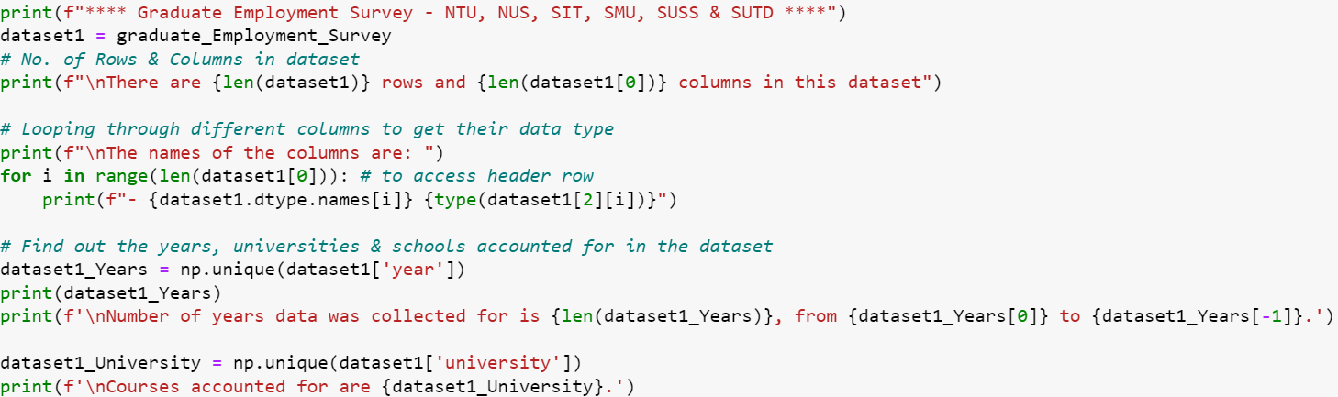
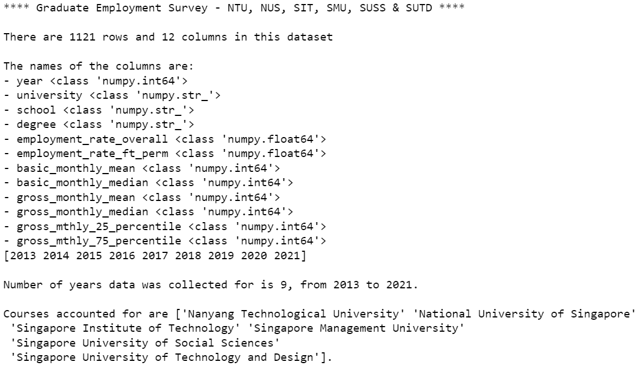
Analysis of Datasets
Performed Analysis to Find Out:
No. of Rows & Columns:
len() function
Names & Data Type of Columns:
For loop
.dtype.name
type()
No. of unique values per Col:
np.unique()
Year
Sex
University

Slide 9
Analysis of Dataset 1
Using np.unique():
Find unique values for column:
School
Check if there is varied naming conventions

Slide 10
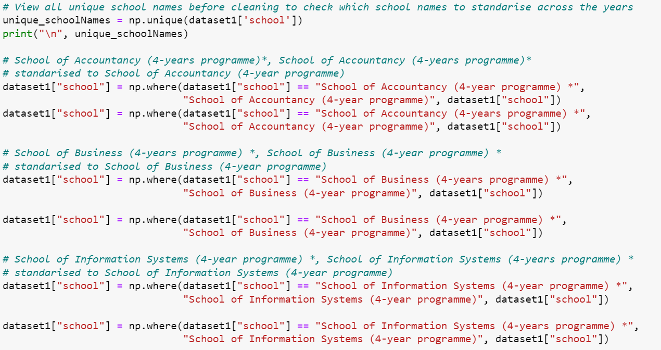
Data Cleaning (Dataset 1)
As there are varied naming conventions in the column (“school”):
Needs to be standardised to make extraction of statistics more accurate
Use numpy boolean indexing & np.where()
Eg. Standardised “School of Accountancy (4-year programme) *” & “School of Accountancy (4-years programme) *” to “School of Accountancy (4-year programme)”

Slide 11
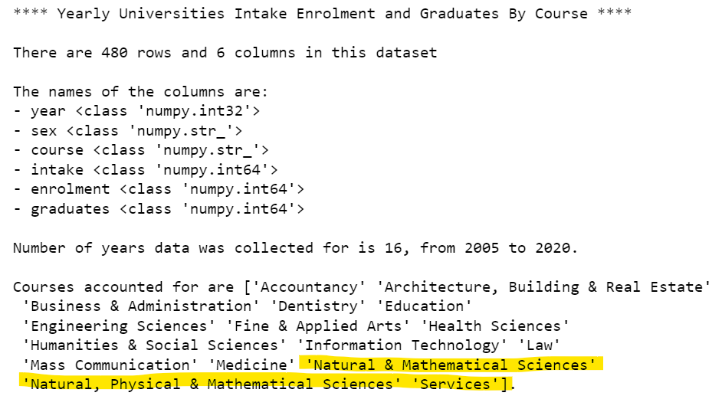
Analysis of Dataset 2
Using np.unique():
Find unique values for column:
course
Check if there is varied naming conventions

Slide 12
Data Cleaning (Dataset 2)
As there are varied naming conventions in the column (“course”):
Needs to be standardised to make extraction of statistics more accurate
Use numpy boolean indexing & np.where()
Eg. Standardised “Natural & Mathematical Sciences) *” & “Natural, Physical & Mathematical Sciences” to “Natural, Physical & Mathematical Sciences”

Slide 13
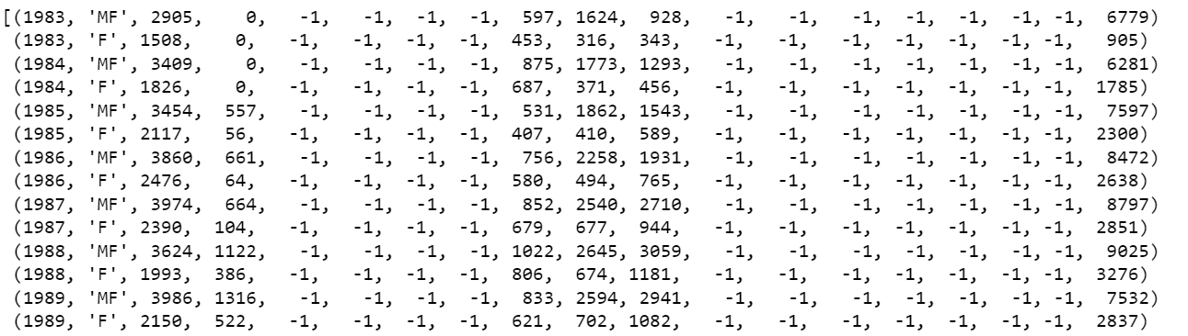
Analysis of Dataset 3
Print(dataset3):
Values of -1 for the column of intake, enrolment, graduates
Which is when certain universities where not opened yet in those years

Slide 14
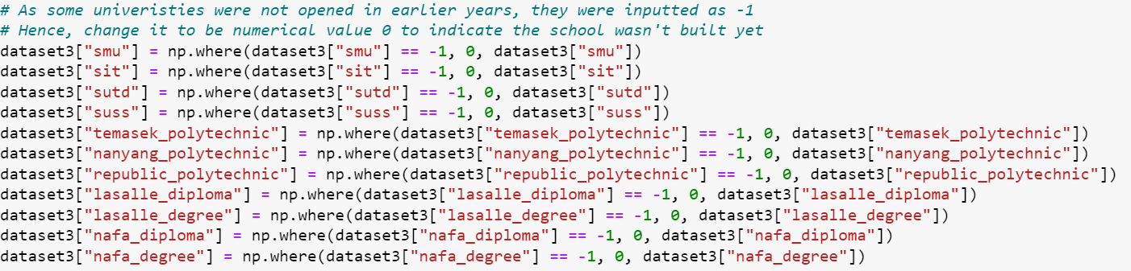
Data Cleaning (Dataset 3)
As there were negatives values for columns that were for counting:
It would mess up our calculations
Use boolean indexing & np.where()
Replaced all values of -1 to 0 to indicate that the University had not opened in those year

Slide 15
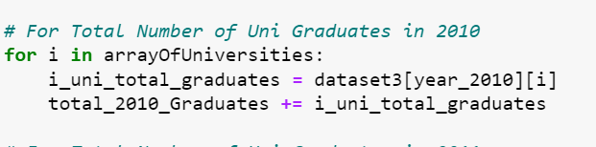
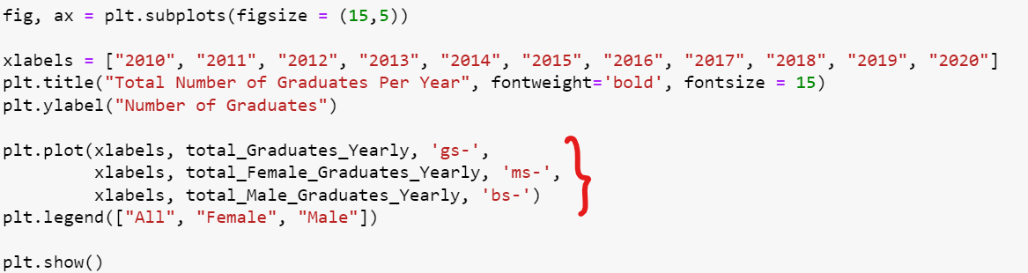
Graph 1: Total Number of Graduates Per Year
Created “arrayOfUniversities” to store unique University names
For loop:
Add up all number of graduates from every University to get the total for that year
Plotted 3 different lines in 1 line graph to display the change in number of graduates in terms of total, female & male

Slide 16
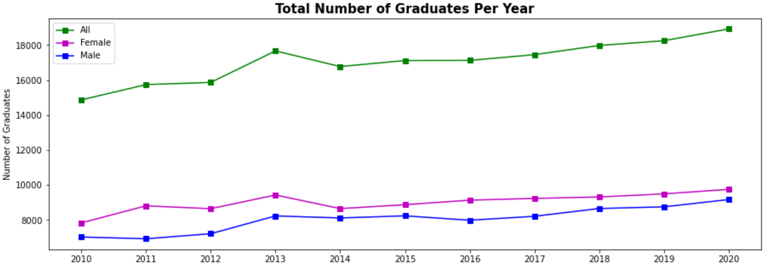
Graph 1: Total Number of Graduates Per Year
There is a steady increase in total no. of graduates
With one sharp increase from 2012 to 2013
There are more females than male graduates every year
This may be due to 2 years NS for the males

Slide 17
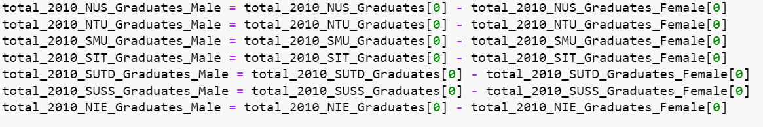
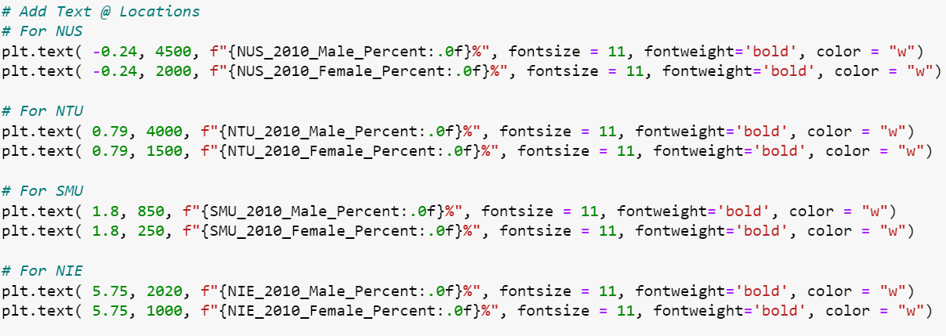
Graph 2: Number of Graduates Per University
To retrieve number of male graduates:
Performed “-” operation to subtract individual elements from arrays containing female graduates & both gender graduates statistics
plt.text():
Add text about percentages as it is visually hard to see difference when the bar length is similar

Slide 18
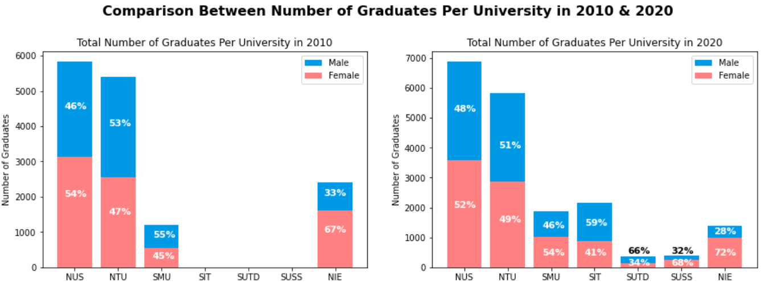
Graph 2: Number of Graduates Per University
NUS has the most number of Graduates
Possibly due to its long history
Generally there is a even proportion of genders or a higher proportion of females per University

Slide 19
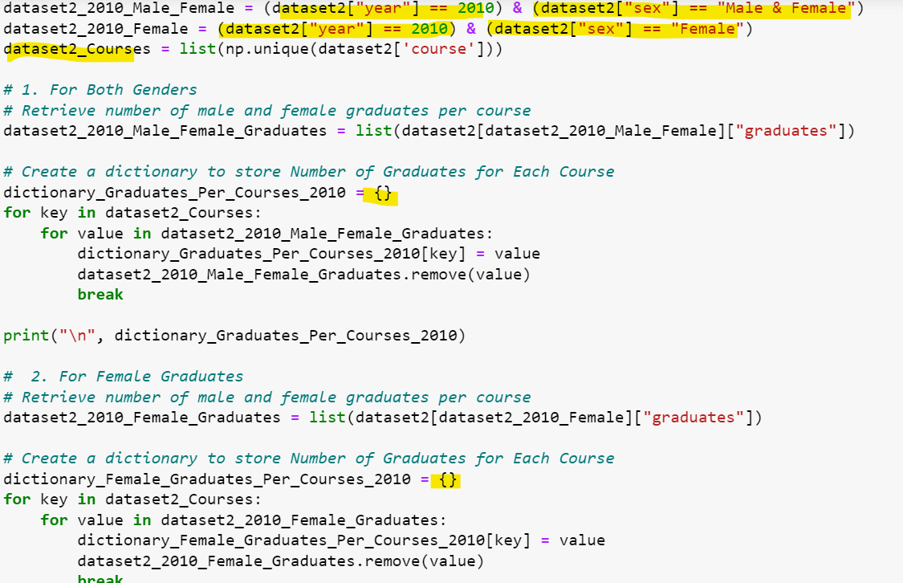
Graph 3 & 4: Proportion of Female To Male Graduates Per Course in 2010 & 2020
Boolean Indexing to select rows only have “2010” or “2020” & “Male & Female” or “Female”
Np.unique(): get unique courses
Make dictionary to loop through the unique courses to get the number of graduates per unique courses

Slide 20
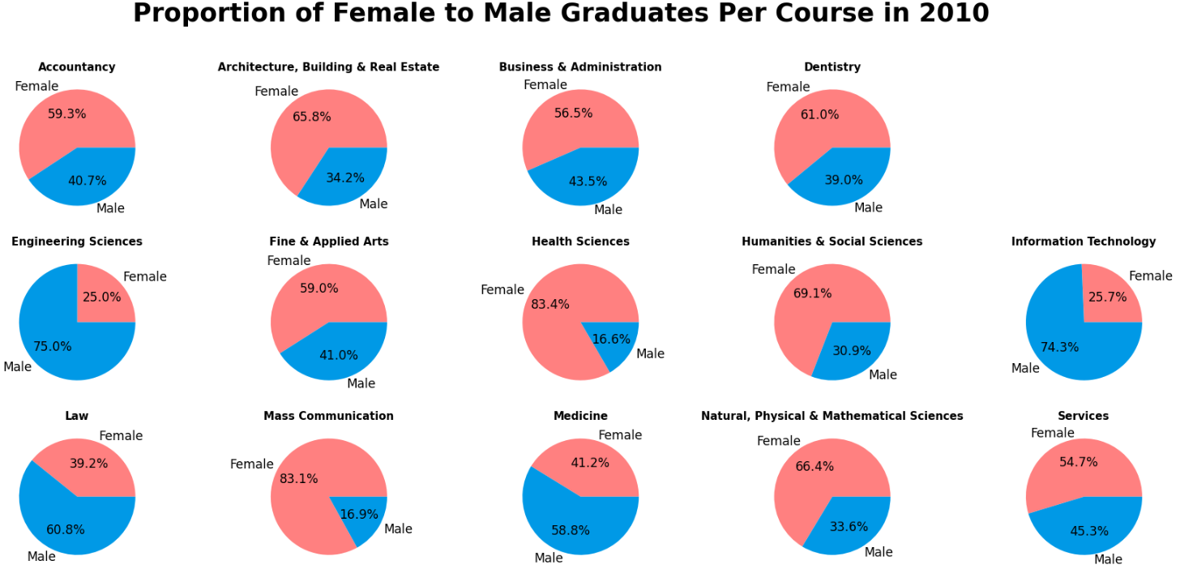
Graph 3: Proportion of Female To Male Graduates Per Course in 2010
Generally across the courses, there are higher proportions of females to males
Especially:
Health Sciences
Mass Communication
Humanities & Social Sciences
Courses with higher proportions of males:
Engineering Sciences
Law
Medicine
Information Technology

Slide 21
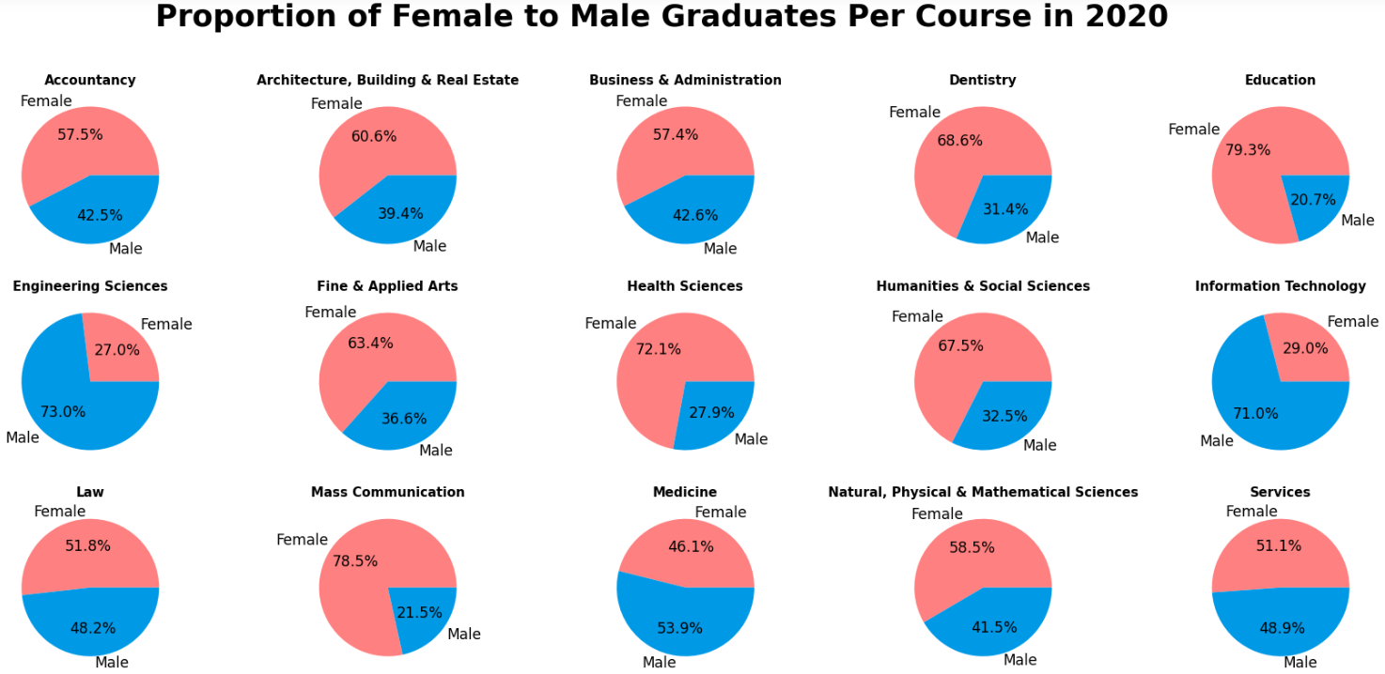
Graph 4: Proportion of Female To Male Graduates Per Course in 2020

Slide 22
Comparison Between Pie Charts
Generally, the proportions of females to males remained higher in the same courses in 2010 to 2020
Exception in 2020:
For Law Course, the female proportion increased
For Health Sciences, the male proportion increased from 16.6% to 27.9%

Slide 23
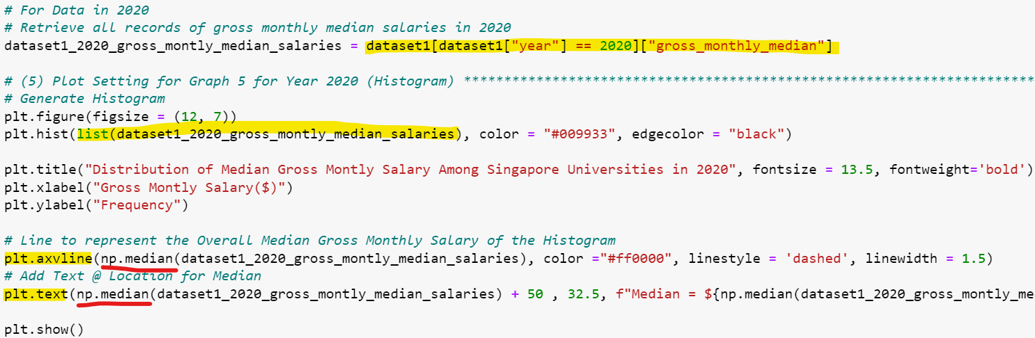
Graph 5: Distribution of Median Gross Monthly Salary Among Singapore Universities in 2020
Boolean Indexing to extract statistics all records for gross monthly median in 2020
np.median():
Get median of histogram
plt.axvline():
Generate a dashed line at median
plt.text():
To add text beside dashed line

Slide 24
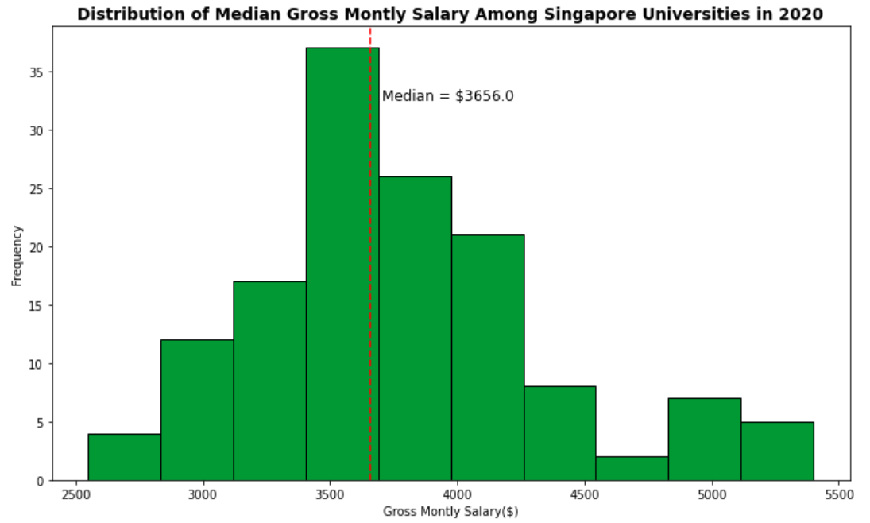
Graph 5: Distribution of Median Gross Monthly Salary Among Singapore Universities in 2020
Distribution is widespread
Distribution is skewed to one direction
Median = $3656

Slide 25
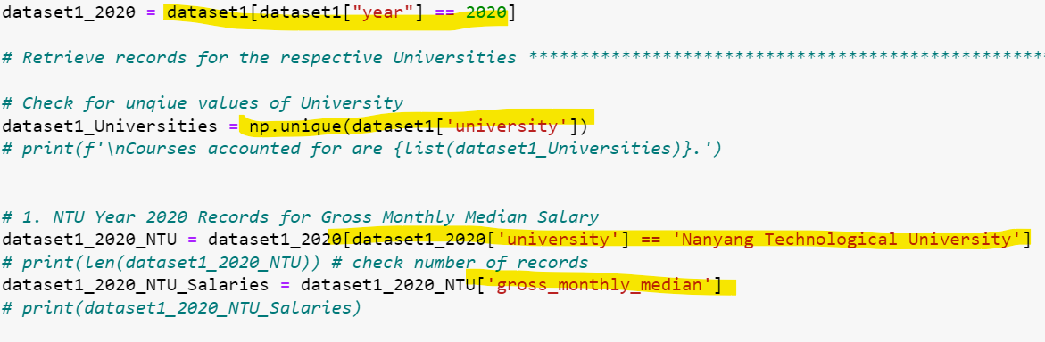
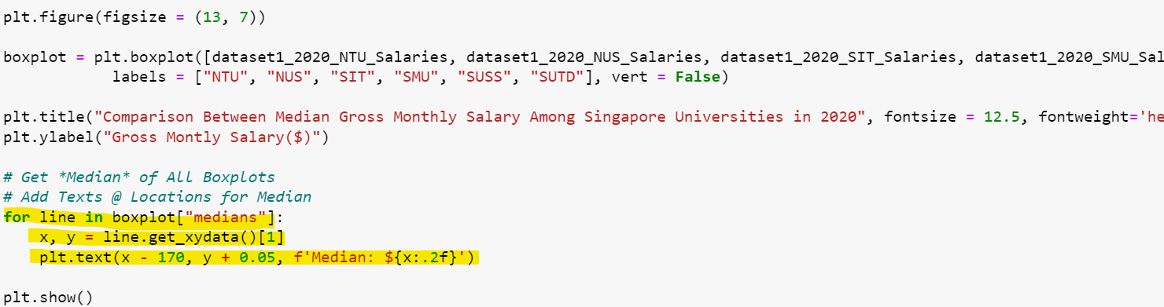
Graph 6: Comparison Between Median Gross Monthly Salary Among Singapore Universities in 2020
Boolean Indexing with unique university values to extract specific rows with the correct university
For loop in boxplot[‘median]:
Retrieve median values from all boxplots & add text to location

Slide 26
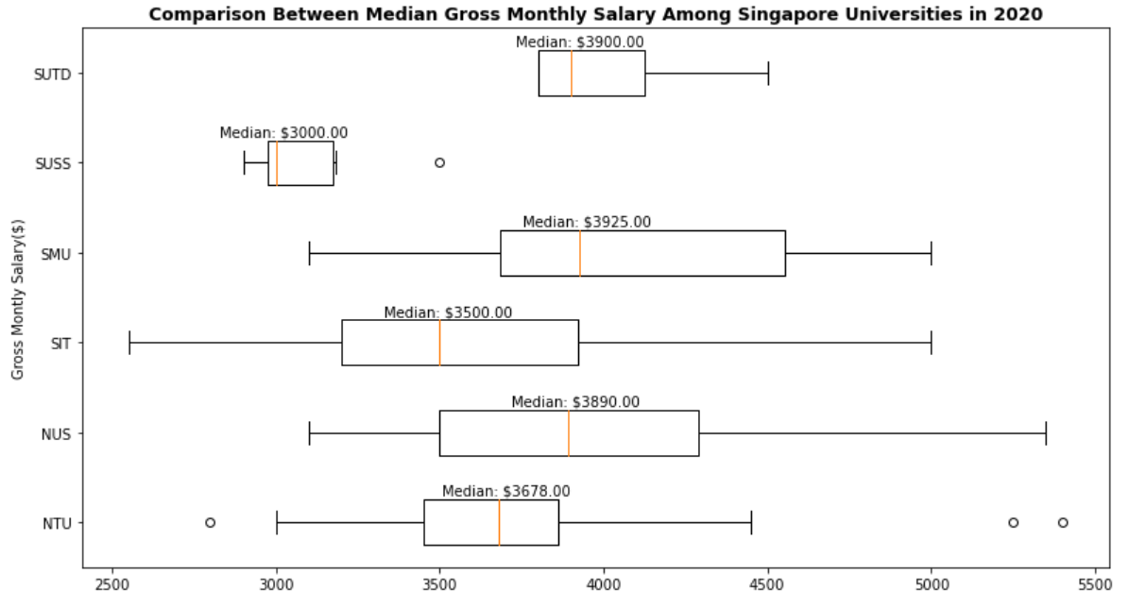
Graph 6: Comparison Between Median Gross Monthly Salary Among Singapore Universities in 2020
SMU has the greatest Median Gross Monthly Salary at $3925
SUSS has the least Median Gross Monthly Salary at $30000
SIT has the widest range of Gross Monthly Salary from $2500 to $5000
SUTD has a tight range of Gross Monthly Salary from $3800 to $4500

Slide 27
Conclusion
Recommendations
Generally, there is more population of female than male in Universities
There is evidence of advertising of courses towards both genders in Universities being effective as seen in the increase in
Proportion of females in the Law Course from 2010 to 2020
Proportion of males in Health Sciences Course from 2010 to 2020
Universities that have a longer history have higher number of graduates and higher median gross monthly income
Advise Universities to advertise courses such that both genders have equal opportunities & exposure to all courses
Advise Universities like SUSS, to refine their courses to be more competitive & to expose their students to the industry, allowing SUSS to gain exposure. This would increase SUSS’s students opportunities, giving them more options in their pay, resulting in an increase in gross monthly salary

Slide 28
REFERENCES
https://data.gov.sg/dataset/graduate-employment-survey-ntu-nus-sit-smu-suss-sutd
https://data.gov.sg/dataset/universities-intake-enrolment-and-graduates-by-course
https://data.gov.sg/dataset/intake-enrolment-and-graduates-by-institutions
https://www.freepik.com/free-vector/office-secretary-with-notebook-pencil-her-hand_10704426.htm#query=office%20lady&position=19&from_view=search&track=sph

